Slide 1
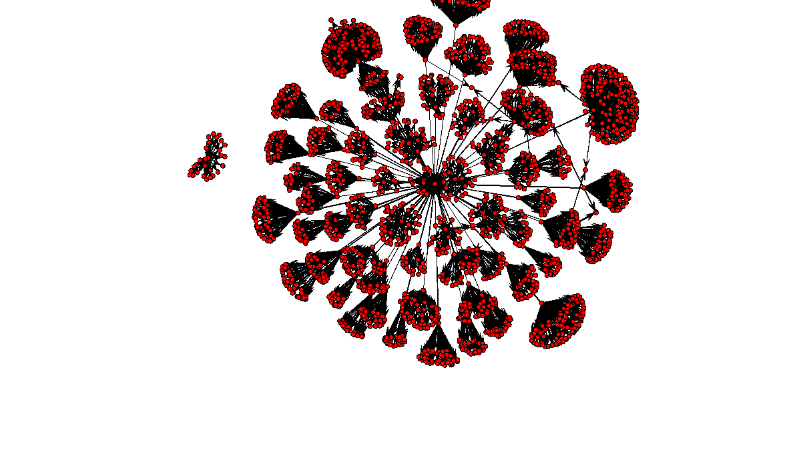
THE COMPANY (REGISTERS) WE KEEP CAN UK PUBLIC COMPANY DATA HELP US SPOT EVIDENCE OF CORRUPTION?
Group 3: Leonie Beyrle, Rasim Alam, Taran Raghuram

Slide 2

Background
Detecting corruption is hard because we lack reliable data about it as only the most egregious corruption cases become public
About 70% of large scale corruption cases involve anonymous companies, which do not disclose their shareholders
Recent push for disclosure of who really owns/ benefits from UK companies
How useful is this new data? Does it just produce “zombie transparency” or does it actually help us spot suspicious behavior?

Slide 3
Our data – 5.6m companies, 7.5m owners, 365k tenders
 | UK Companies House Database (government) | UK Persons of Significant Control Register (government) | EU Opentender Database (Digital Whistleblower Project)
What does the data tell us | Full universe of UK companies | Who owns / benefits from UK companies → Owner = 25% or more of shares or voting rights | Companies which received contracts from UK public entities (2009-2019)
Key variables | Unique company number, name, registered address, incorporation date, industry | Owner type (individual or company), name, address, owner nationality | Tender and bid prices, buyer and bidder names, tender descriptions
Obser- vations | Approx. 5.6m companies | Approx. 7.5m owners (individuals and corporates) | 365,000 tenders awarded by UK public entities in last 11 years
Notes:
FYI for the tenders: 365k unique tenders, 235 awarded, 150k unique awarded tenders tagged to companies we can look at in our file (46k out of the 150k companies)

Slide 4
Our Goal – What‘s new about what we did?
Existing research on UK company owners is:
Sparse: Ownership register only launched in 2016
Driven by NGOs, not academic researchers
Focused on analyzing specific companies (already suspected of illicit behavior) rather than analyzing the whole dataset and company network
Uses canned visualization tools not machine learning
Hampered by unclean data
Companies House does not verify any information provided
Data entry through text fields which leaves data riddled with typos and mistakes
Opentender dataset does not use unique company numbers
We took a bottom-up approach
Descriptive analysis to identify companies which do not appear to be complying with PSC disclosure requirements
Map company networks to identify interesting/ suspicious patterns

Slide 5
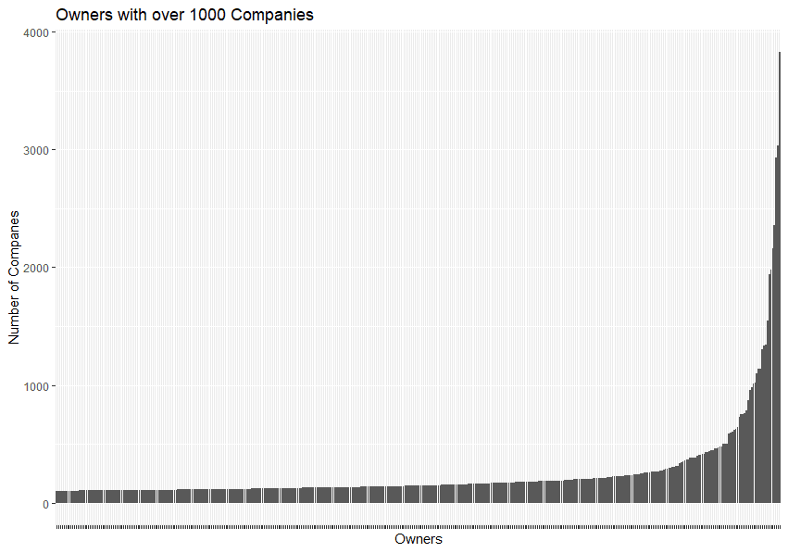
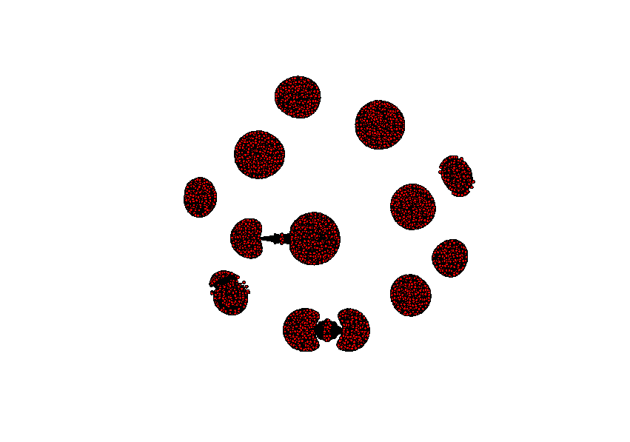
Some PSCs own vastly more company than others
Each cluster represents the companies owned by such a superowner
A small number of PSCs own/ control vast numbers of companies.
Notes:
As could be seen from the random sample on the previous slide, there are large clusters of companies in the dataset which are connected through common ownership
We took a closer look at all owners in the dataset and found that some of them are Super-Owners
Closer look at two common shapes next

Slide 6
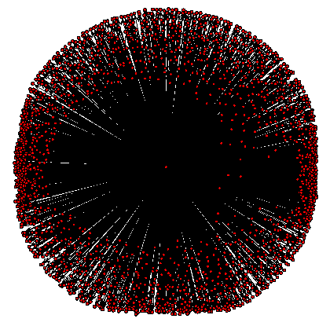
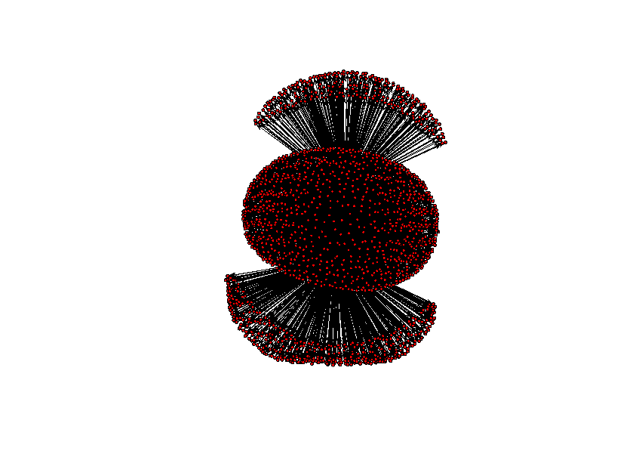
Why do “Super-Owners” exist?
PSC is a serial entrepreneur -Douglas John David Perkins and Specsavers
PSC owns a company incorporation firm - David Dean
Notes:
Closer look at two common shapes
Left: Douglas John David Perkins and Specsavers
Optician chain
Douglas Perkins founded the company and owns - inter alia - its main holding company → between them they hold a thick network of companies → that’s the blob in the middle
Specsavers has a fairly unique franchise model
Each local store is its own company run by a third party
The central specsavers holding company holds 50% of the shares in each of these local companies - those are the nodes sticking out at the top and the bottom - none of which have any connections to each other
“Buy a flower not a bud”
Right:
David Dean of Charterhouse
personally owns over a thousand companies which are not connected to each other [can we really say this?]
Likely to be shelf companies - which have been created and are waiting for a buyer; why would a buyer want a shelf company
No need to wait for incorporation paperwork to be done
Older companies look more legitimate
This can be a completely legitimate service BUT it’s also what you would want to use if you had something to hide

Slide 7

Some UK companies are owned by other companies in secrecy jurisdictions
The aim of the PSC register is increasing ownership transparency
Companies have to disclose the individuals owning/ controlling them OR
Another company which has disclosed information about its own shareholders
However, we find over 8000 companies owned by corporations in secrecy jurisdictions
This is highly unlikely to be compliant with UK law
Notes:
The whole point of the PSC register is ownership transparency - making it clear who sits behind a company
Therefore companies are usually expected to disclose which individual owns them
They are only allowed to list another company as a PSC if that company itself is sufficiently transparent about its own shareholders - There are detailed requirements in UK law re what “sufficiently transparent” means
BUT we know what it does not mean
Define Secrecy Jurisdiction and the definitions of “secret” and “mega secret”
offer no/ very limited information on who the shareholders are
no universally agreed definition → we used data from the Financial Secrecy Index (an initiative by the NGO Tax Justice Network)
We find 8432 UK companies owned by entities registered in secrecy jurisdictions
What more do we know about these companies → most clusters are small 2-10 companies but some are huge → let’s look at the largest one

Slide 8
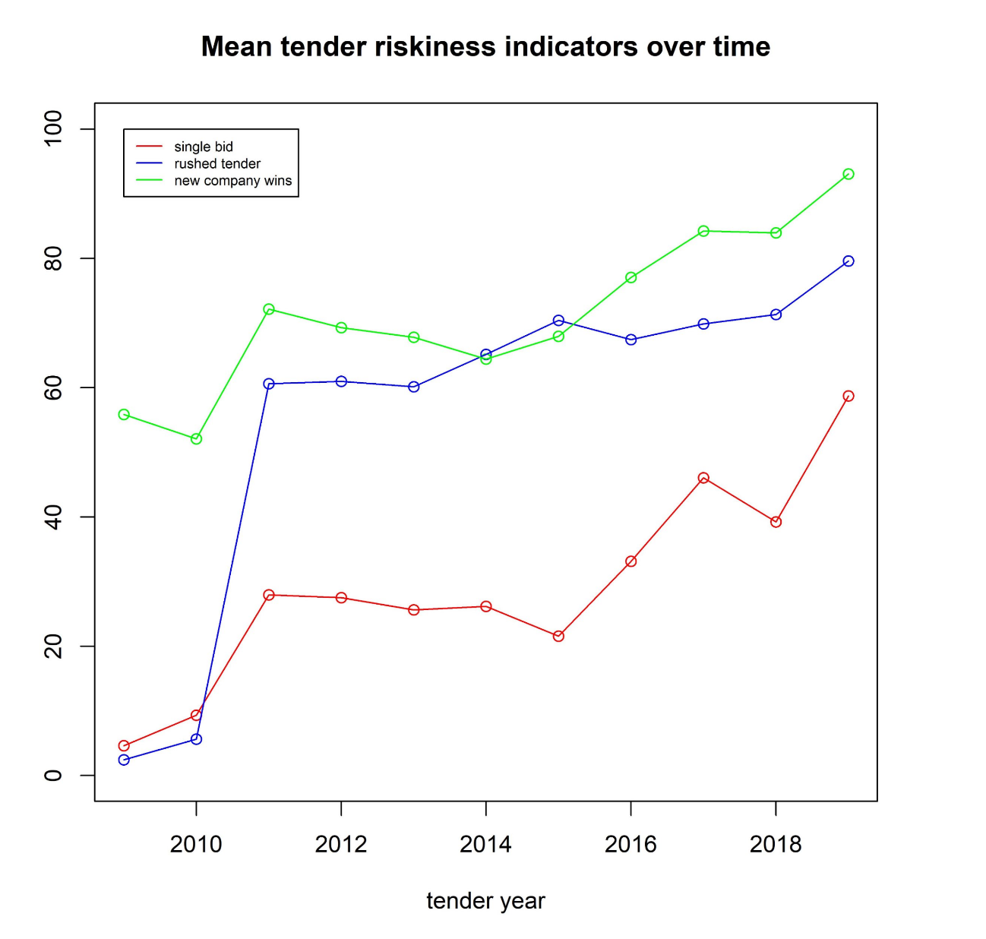
UK public procurement has become less transparent over recent years
Opentender dataset
PSC dataset
buyer issues tender
seller/ winning bidder is awarded the tender
PSC owns/ controls winning bidder
Who is awarded the tender?
Who reaps the financial reward?
Notes:
Main takeaway from last analysis was that certain companies are registered in places they shouldn’t be, and these companies may be in violation of UK law
This analysis seeks to understand whether the UK government is paying those companies for services via procurement contracts
Quick primer - public procurement is the main way government agencies spend money - govt agency puts out a notice, and companies make bids on this “tender”, generally with the lowest bid getting the contract (there are exceptions)
Huge topic for the three of us over at the school of govt
The procurement data we used comes from a separate dataset and has not been combined with the ownership data before
The dataset seems to indicate that the quality of the contracts is getting worse over time - our interpretation is that these metrics were only applied to the subset with data initially, so part of the reason for the spike is an increase in visibility of bad contracts
Nevertheless, we think it’s worthwhile motivation to explore whether the companies we just talked about are getting paid by the UK govt
Background
Opentender dataset already contains integrity indicators, where each tender in the dataset is rated according to several criteria on a scale of 0 to 100
[I subtracted the integrity scores from 100 to turn them into riskiness indicators - That was easier to interpret]
These are the mean scores of 3 key risk indicators over the years

Slide 9
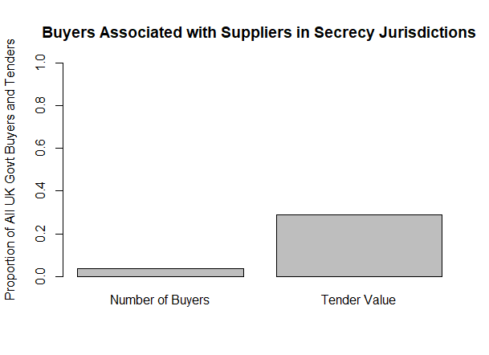
Companies in Secrecy Jurisdictions work with the Largest Government Buyers
Suppliers receive funds in proportion to their number - around £600M out of annual £300bn UK spending
Buyers who give contracts to companies in secrecy jurisdictions comprise about 3% of buyers but 29% of total procurement funds
This includes all contracts, not only those going to suppliers in secrecy jurisdictions
Notes:
So these bidders are getting larger contracts than the average company, and the public agencies who work with them are some of the largest public agencies
Bidders in secrecy jurisdictions are only 0.2% of all bidders and get 0.4% of procurement funds (likely an underestimate due to data matching issues).
Of the buyers they are associated with, they are x% of all bidders and get y% of all proc funds

Slide 10
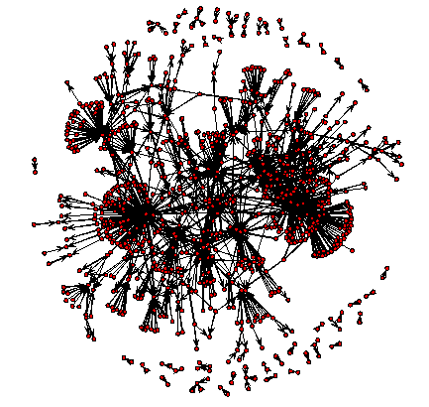
Public Tenders and Secrecy Jurisdictions
Directional graph - arrows point from buyers to suppliers (red dots represent both types of entities)
Clusters indicate supplies who benefit from multiple government buyers
Includes around 700 unique buyers and 200 suppliers across ~ 2000 contracts
Notes:
This graph looks at both buyers and contractors. Distinguishing is done through looking at arrows - Arrows indicate a contract going out from buyer to supplier
Some companies benefit from only 1 buyer, a few benefit from many buyers. And significance of arrows across clusters mean that some buyers give to multiple suppliers
20,000 total UK buyers in dataset total

Slide 11
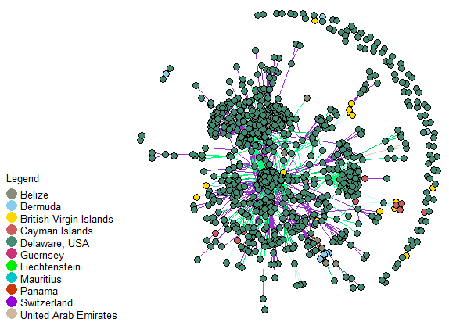
Companies registered in Secrecy Jurisdictions who won public contracts
Notes:
Same plot as prior slide, with location of those companies in secrecy jurisdictions - most who receivie public funding are in Delaware
Buyers are also included and colored by the companies they’re connected to. Slightly exaggerating the number of companies in Delaware, but majority of associations are in Delware
So while this isn’t illegal, we just don’t know where this money’s really going, so this open data register is failing its theory of register

Slide 12
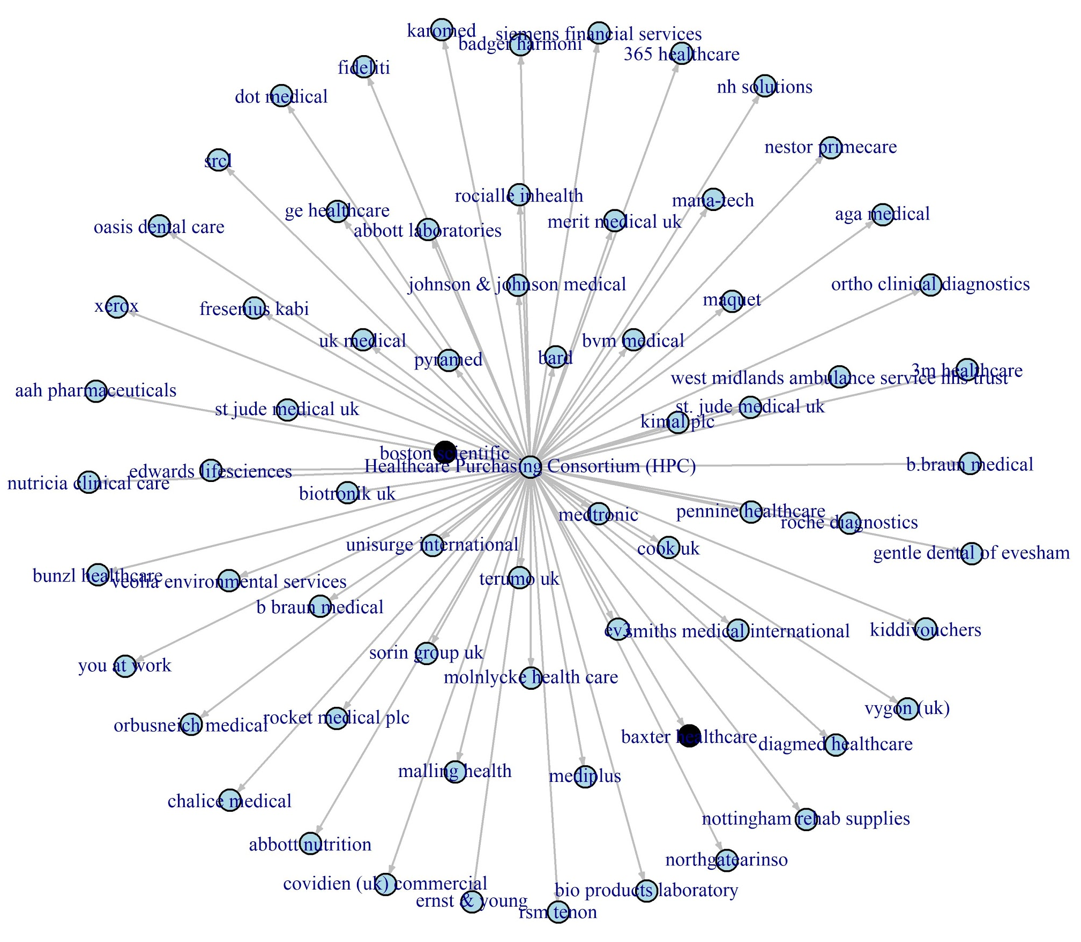
Secrecy Buyers - HPC Example
Owner Registered in Secrecy Jurisdiction
Owner Not Registered in Secrecy Jurisdiction
Notes:
The HPC is the organization is responsible for procuring much of the supplies needed for a part of the NHS (parts of London and West Midlands) - about 1/4th of NHS trusts, 2.4 billion pounds. ¼-⅓ of all health care procurement in the UK
Not necessarily illegal to be in a secrecy jurisdiction - but anyone who’s beneficial owner is a company that lies in a secrecy jurisdiction is cause to be suspicious as it makes monitoring more difficult. And we think by looking at the data in this way through networks, we can gain greater insight and help govts ensure they’re spending their money wisely

Slide 13
Future Updates
Better linkage of PSC (owner) data to general company data
More sophisticated fuzzy matching procedure to match more contracts to suppliers in PSC dataset
Procure additional features about firms (eg: size, assets - currently in PDFs) to run a “community detection” model
Subcontractor chains for companies in secrecy jurisdictions
Notes:
Don’t run through - end on previous

